Slide 1
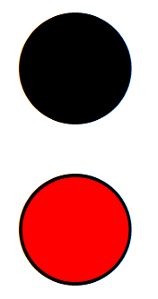
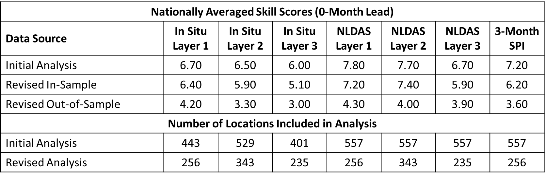
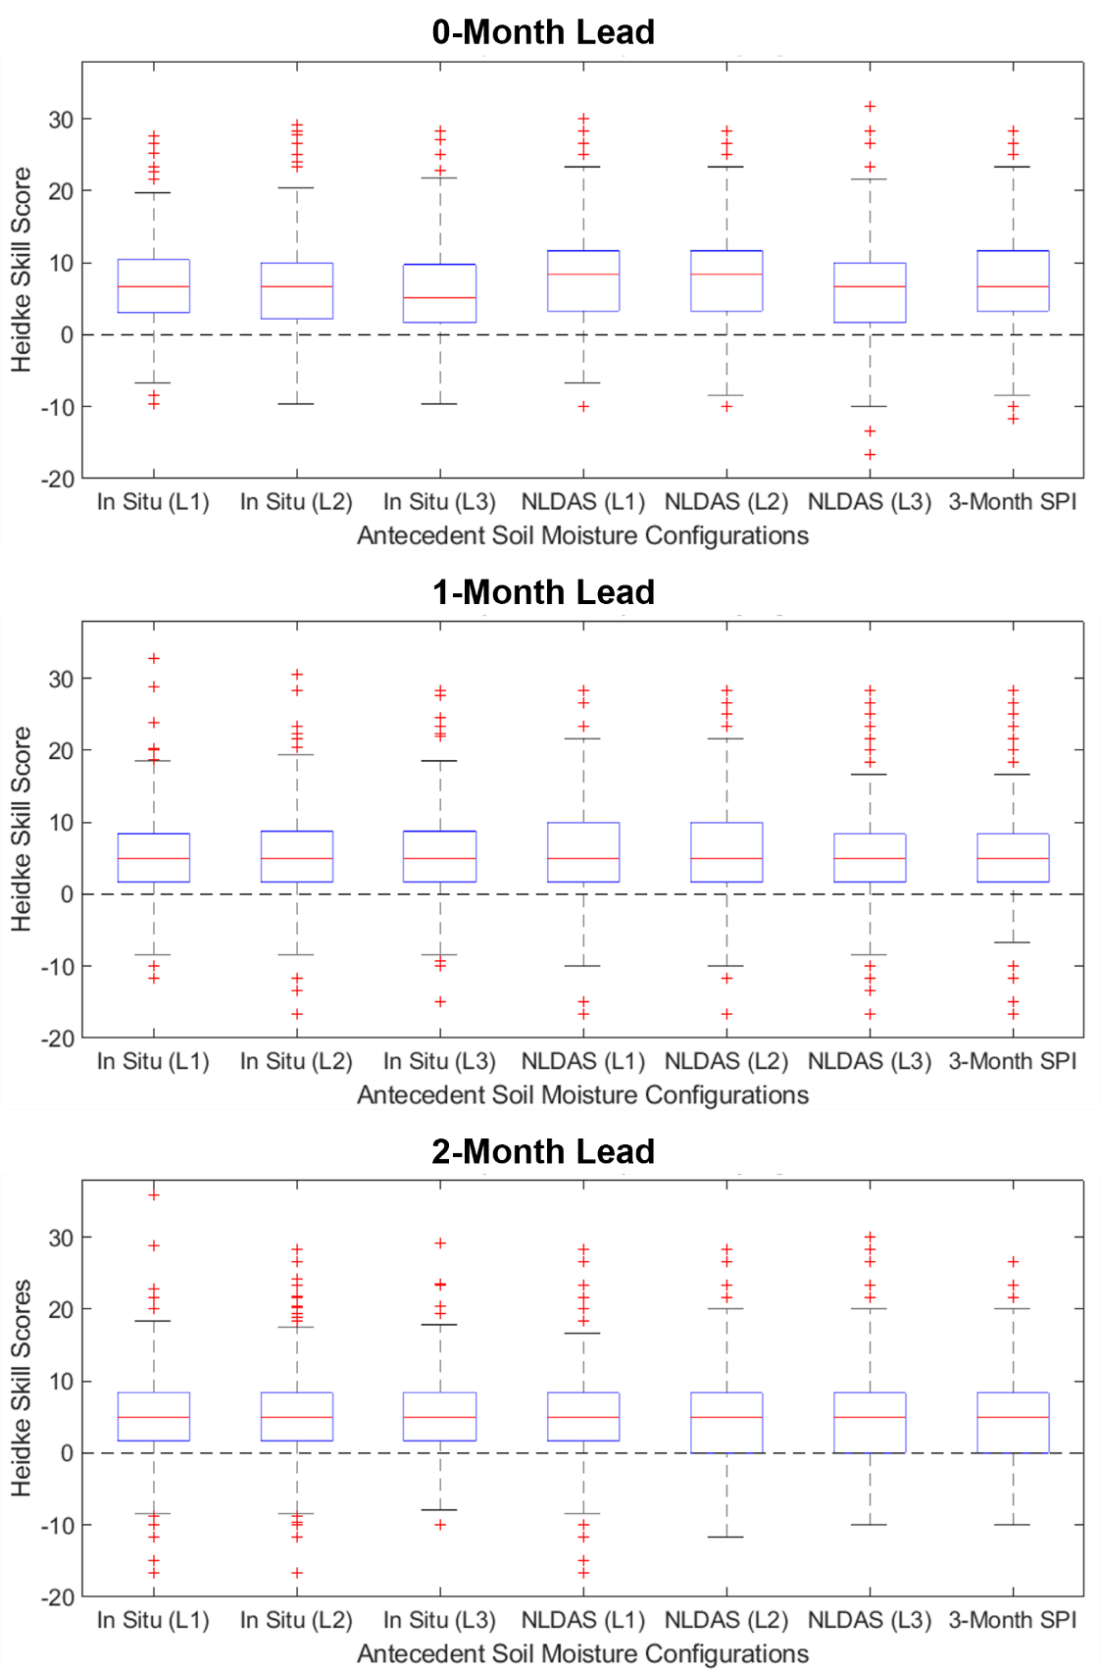
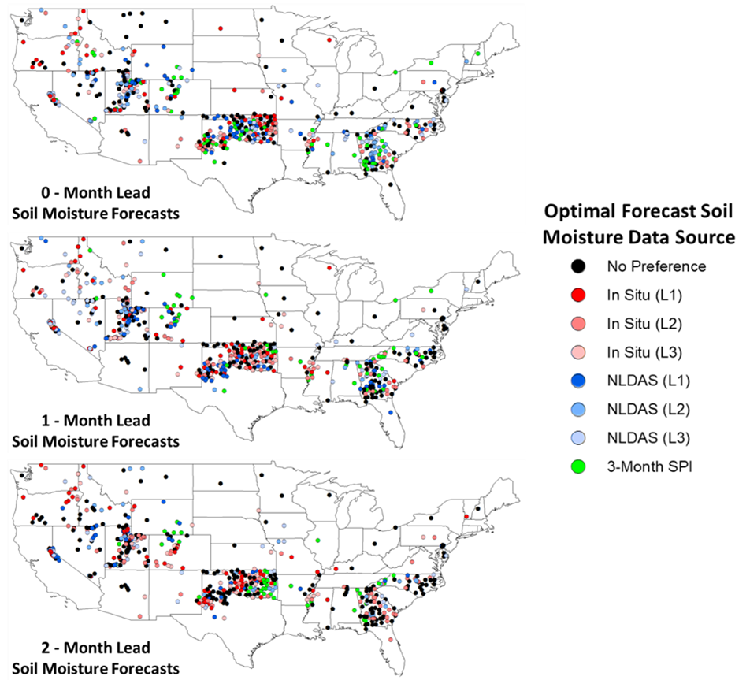
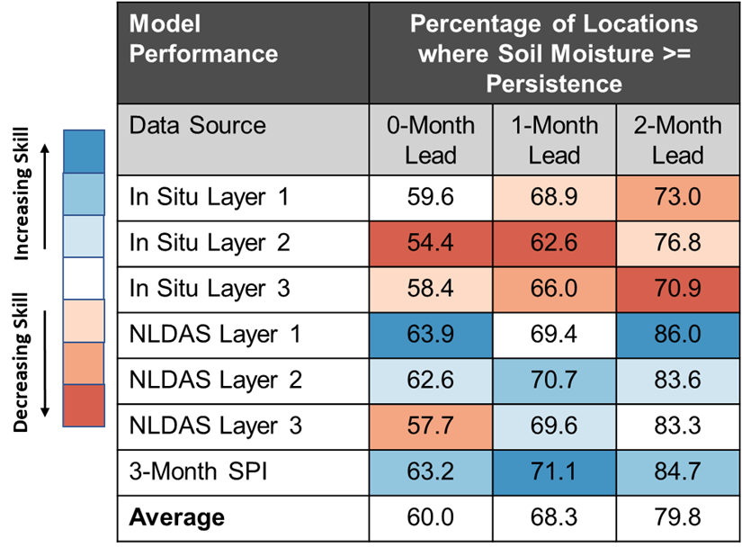
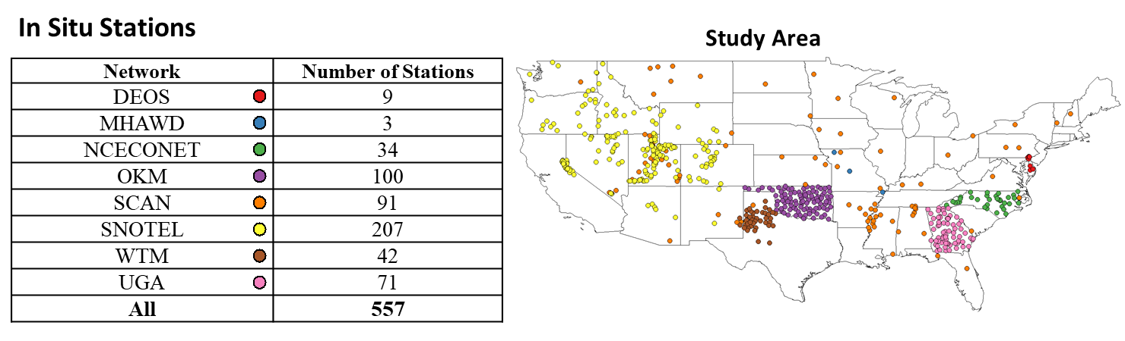
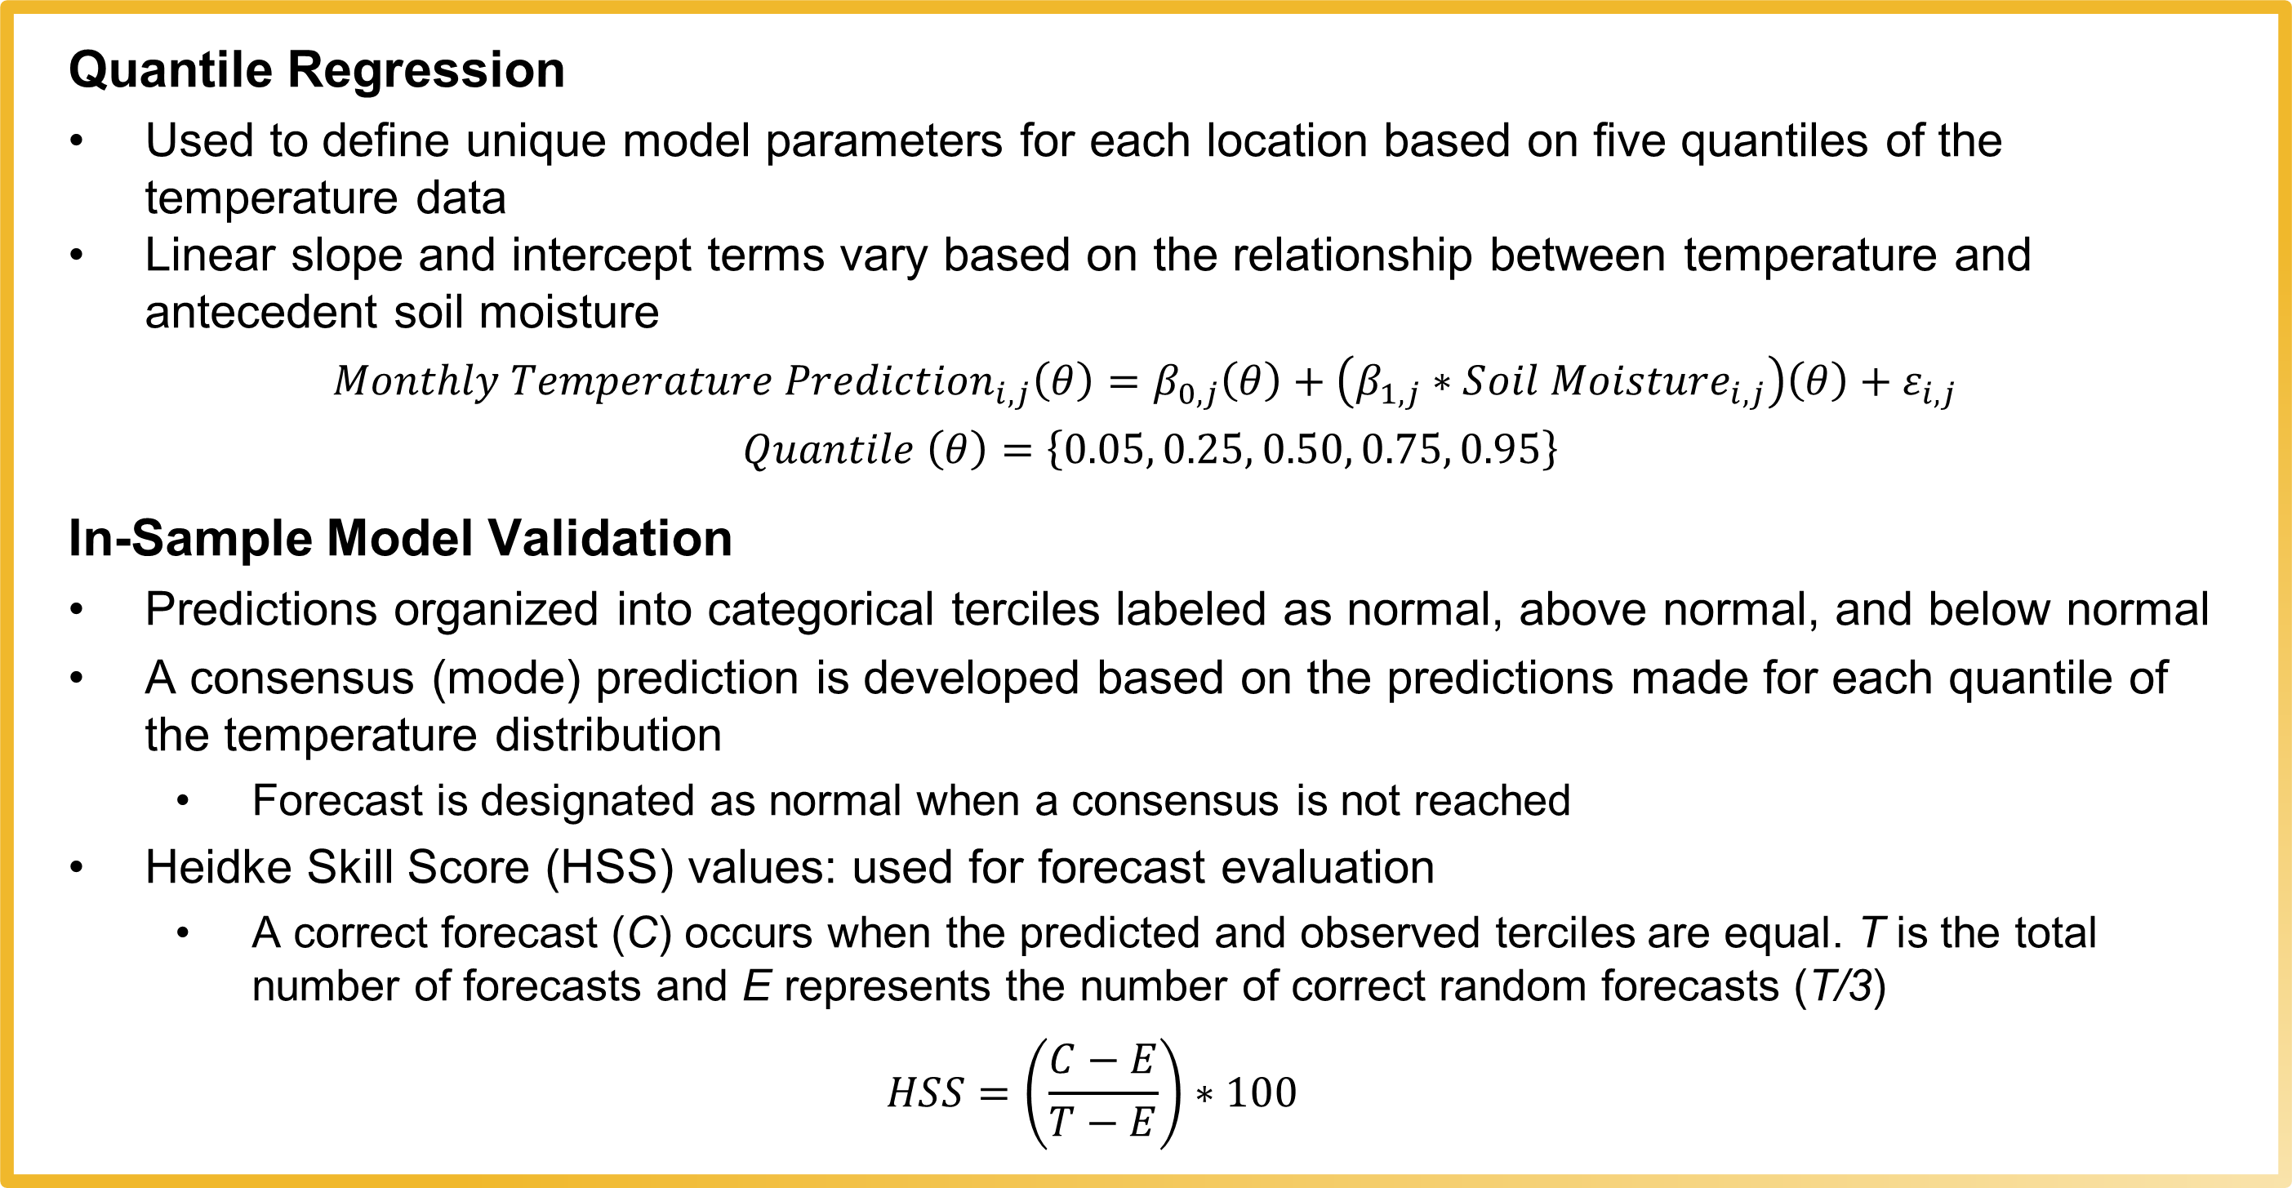
Utilizing Improved Model Validation Techniques to Reevaluate the Sensitivity of Monthly Temperature Predictions to Multiple Sources of Soil Moisture Data
Zack Leasor (leasorz@missouri.edu) , Steven Quiring (The Ohio State University), Chen Zhao (Verisk)
Motivation
Methods
Improved Model Validation Techniques
Soil moisture can improve temperature forecasts at subseasonal-to-seasonal (S2S) timescales, particularly during the warm season. This study builds upon previous work that integrated soil moisture data from direct in situ measurements, land surface models, and proxy estimates into statistical forecasts to examine how the source of data impacts model performance. A limitation of this method was that data sensitivity was only tested using in-sample model validation. Therefore, this study uses a more stringent selection of in situ soil moisture sites to conduct out-of-sample model validation and reevaluate the sensitivity of predictions to the soil moisture data source.
Quantile Regression
Used to define unique model parameters for each location based on five quantiles of the temperature data
Linear slope and intercept terms vary based on the relationship between temperature and antecedent soil moisture
$${Monthly Temperature Prediction}_{i,j}\left(θ\right)=β_{0,j}\left(θ\right)+\left(β_{1,j}∗S{oil Moisture}_{i,j}\right)\left(θ\right)+ε_{i,j}$$ $Quantile \left(θ\right)=\left\{0.05, 0.25, 0.50, 0.75, 0.95\right\}$
In-Sample Model Validation
Predictions organized into categorical terciles labeled as normal, above normal, and below normal
A consensus (mode) prediction is developed based on the predictions made for each quantile of the temperature distribution
Forecast is designated as normal when a consensus is not reached
Heidke Skill Score (HSS) values: used for forecast evaluation
A correct forecast (C) occurs when the predicted and observed terciles are equal. T is the total number of forecasts and E represents the number of correct random forecasts (T/3)
$$HSS=\left(\frac{C−E}{T−E}\right)∗100$$
Results from the initial analysis are based only on in-sample model validation with a tolerance for up to 20 months (33.3%) of missing monthly data
To reevaluate the sensitivy, a more stringent selection of stations (no missing data) is used, eliminating 153 locations from the initial analysis (Figure 3)
Rather than using an in-sample model validation, an out-of-sample cross validation is implemented by removing one year and holding out for model validation 10 times (folds)
The resultant skill scores are based only on the revised out-of-sample cross validation
Figure 3. Map displaying locations that are removed from analysis because there is missing data at all three depths (red). Locations that have at least one soil layer with a complete monthly in situ record (black) are used in the improved model validation techniques.
At least one layer with complete in situ record
No complete in situ records (removed from analysis)
Data
Monthly in situ soil moisture data (2009 – 2018) retrieved from eight networks (Figure 1)
Quality control used to identify stations continuously operating from 2009 to 2018
All measurements standardized as volumetric water content (VWC) percentiles
In situ data are compared with monthly soil moisture data from the North American Land Data Assimilation Phase-2 (NLDAS-2) Noah model
Soil layer 1 (0 - 10 cm), Soil layer 2 (10 - 40 cm), Soil layer 3 (40 - 100 cm)
In situ data are aggregated to NLDAS layers by averaging any measurements that fall within the range of depths
Monthly temperature and precipitation data from PRISM (http://prism.oregonstate.edu)
Precipitation data used to calculate the Standardized Precipitation Index (SPI)
Table 1. National distributions of HSS values for 0-month lead warm season maximum temperature forecasts made from 2009 – 2018. Results are compared between the initial analysis using all stations and the revised analysis with a more stringent selection of stations. Results are also compared based on skill scores using in-sample and out-of-sample model validation.
Results
Conclusions
Even with improved data quality and model validation techniques, preliminary results continue to show that in most cases the statistical forecast models are not sensitive to the type of soil moisture data used
Improving the quality of data and model validation techniques reduces the overall skill of soil moisture-based temperature forecasts
Future research will implement out-of-sample model validation techniques to test whether soil moisture-based forecasts are more skillful than persistence forecasts
a)
b)
c)
Figure 2. (a) National distributions (n = 557) of HSS value for 0-, 1-, and 2-month lead warm season maximum temperature forecasts made from 2009 – 2018. Forecasts were made at each station location with unique quantile regression models using different antecedent soil moisture configurations. (b) Maps displaying the data source and layer depth which promotes the highest forecast skill in warm season 0-, 1-, and 2-month lead quantile regression forecast models. Model performance is based on the calculation of HSS values from 2009 – 2018. (c) The percentage of locations where forecasts using varying soil moisture data sources have forecast skill greater than or equal to the skill of forecasts using temperature persistence. Forecast skill is based on HSS values calculated from warm season quantile regression models during 2009 – 2018.
Figure 1. Study area map displaying the locations and network providers for 557 in situ stations used in this analysis. All data were provided by The Ohio State University (http://www.nationalsoilmoisture.com) and the University of Georgia weather network (http://www.georgiaweather.net)

Slide 2
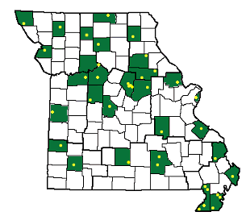
Characterizing Drought Intensity, Frequency, and Duration in Missouri using the Missouri Mesonet Network
Zack Leasor (leasorz@missouri.edu) , Thomas Schwent (tpsqmd@umsystem.edu)
Motivation
Methods
The Future
Missouri has never conducted a drought climatology analysis using Missouri Mesonet data. As a result, there is a lack of observed data for drought analysis, leading to the use of derived products from the NEXRAD network and other sources to fill in the gaps. Conducting this analysis will provide a better understanding of Missouri’s drought patterns over the past 20 years. This is important because drought patterns in Missouri have significant implications for various sectors, including agriculture, water resources, and public health.
Data Collection
Daily precipitation data was manually downloaded from the Missouri Mesonet web pages.
Quality control (QC) was performed to ensure the data's date range, identify missing dates, and flag anomalous values.
The daily precipitation data was then aggregated into monthly totals and formatted to be compatible with the NOAA SPI Generator.
Derived Data
The SPI Generator data was reformatted to export as Excel spreadsheets, and subsequently, converted to CSV files for future mapping purposes.
Derived statistics for each station included SPI, drought period, and drought frequency.
These statistics were calculated for 1M, 3M, 6M, and 12M SPIs.
Future Directions:
Trend Analysis: Identify and analyze long-term trends in precipitation patterns across Missouri.
Drought Climatology: Develop a comprehensive drought climatology for the state.
Streamline Data Collection: Implement automated data acquisition processes to ensure continuous data updates.
Long-Term Data: Prepare for a more extensive 30-year dataset and associated analyses.
Product Development: Create user-friendly drought products for stakeholders in agriculture, water management, and other sectors.
Radar Data Evaluation: Conduct a thorough evaluation of the accuracy and reliability of radar-derived precipitation data.
Data
Daily Precipitation Data (Jan 2000 – May 2024) sourced from the Missouri Mesonet (http://agebb.missouri.edu/weather/stations/) was utilized for this study.
Quality control measures were implemented to distinguish usable and unusable stations.
While most measurements are from the Missouri Mesonet, in cases where data was unavailable, the following sources were used, in the specified order:
COOP Station Data
National Water Prediction Center Precipitation Estimates.
The time range of January 2000 to May 2024 was selected as it conveniently follows the conclusion of a drought period for the state. This approach ensures that drought frequency and duration statistics are not skewed. Although a 30-year dataset starting from 1994 would have been ideal, the limitation was the availability of data, as the Missouri Mesonet archive only extends back to 2000.
Results
No Missouri Mesonet station within the county
Missouri Mesonet station within the county
Point location of Missouri Mesonet station
Figure 1. Study area map displaying the locations of Missouri Mesonet stations (not all used in this analysis). All data were provided by The University of Missouri (http://agebb.missouri.edu/weather/stations/)
Figure 2: Monthly 3-month standard precipitation index values from January 2000 to May 2024 for five locations across Missouri: NW MO (Corning, Atchison County), NE MO (Novelty, Knox County), SW MO (Lamar, Barton County), SE MO (Portageville, Pemiscot County), and C MO (Columbia-Sanborn Field, Boone County) are depicted. Each line in the graph represents a different location, as indicated in the legend. This visualization effectively demonstrates the temporal and spatial variability of drought conditions across Missouri over the 24-year period, offering valuable insights into the region's drought climatology. Notably, the graph highlights significant temporal variability in SPI values, as well as distinct regional differences.

